Slide 1





Cyflwyniad i’r Dangosfyrddau a ddatblygwyd ar gyfer Gofal Sylfaenol yng Nghymru
Gwminar
1^{af} Gorffennaf, 2025

Slide 2
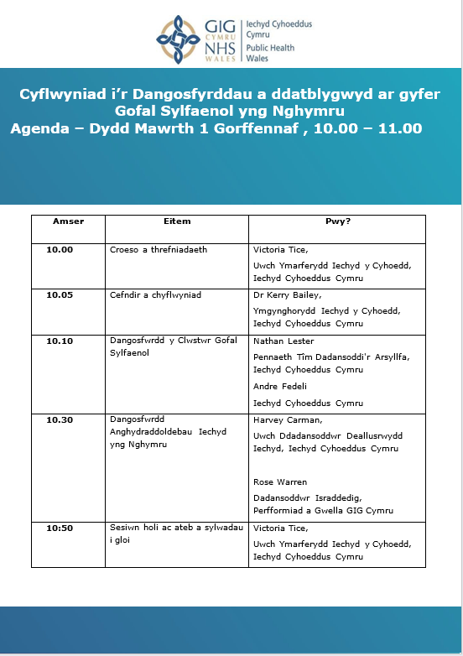
Agenda

Slide 3
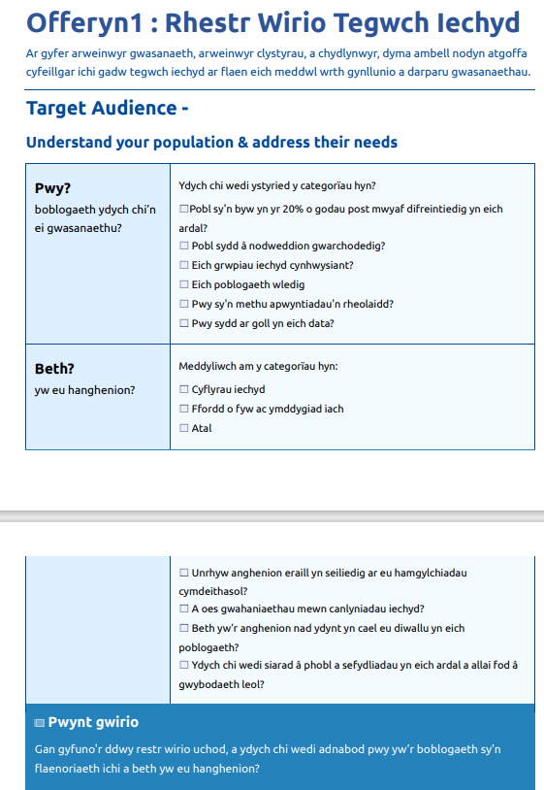
Gofal Sylfaenol Un
Sut i droi data yn gamau gweithredu cyfartal
Notes:
Best available data
Made it to be useful - very under reported and vulnerabe group
Lack of data and evidence, bought together data / evidence aviaable to highlight the need but is not likely to represent the actual situation,

Slide 4
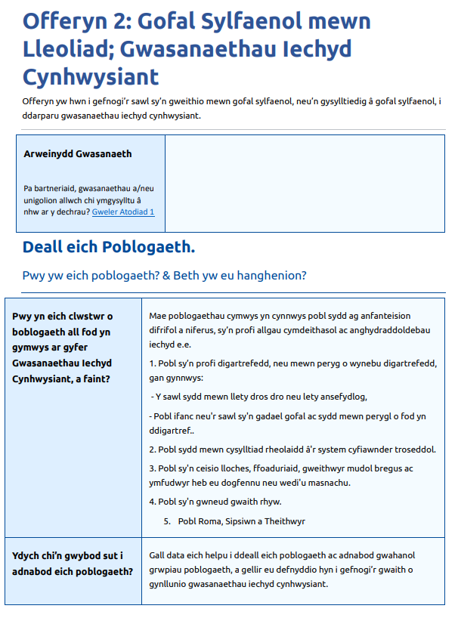
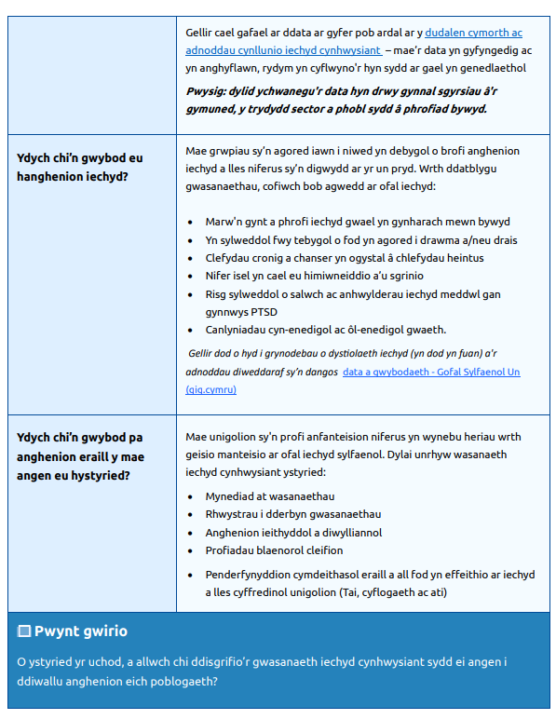
Gofal Sylfaenol Un
Notes:
Best available data
Made it to be useful - very under reported and vulnerabe group
Lack of data and evidence, bought together data / evidence aviaable to highlight the need but is not likely to represent the actual situation,

Slide 5
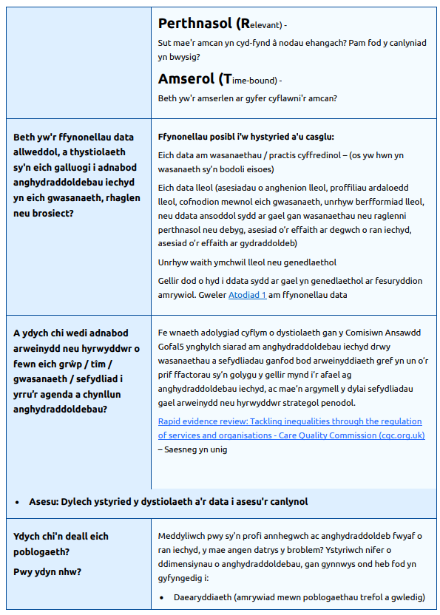
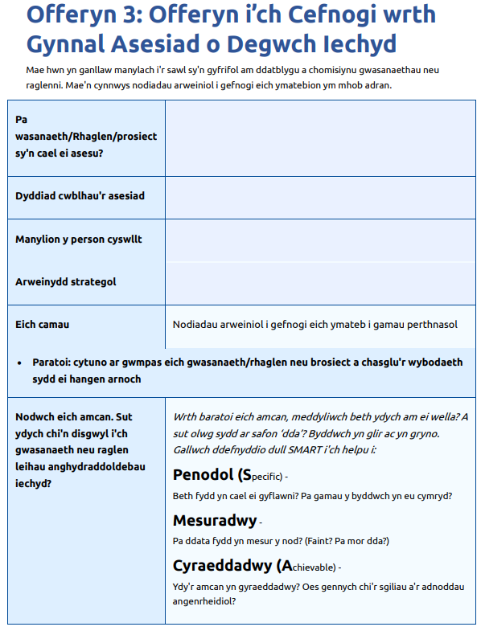
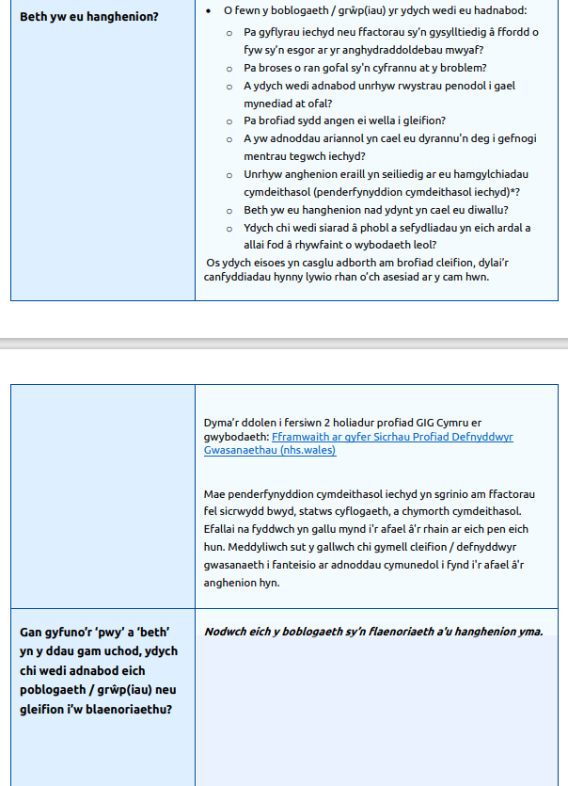
Gofal Sylfaenol Un
Notes:
Best available data
Made it to be useful - very under reported and vulnerabe group
Lack of data and evidence, bought together data / evidence aviaable to highlight the need but is not likely to represent the actual situation,

Slide 6
Sesiwn cwestiwn ac ateb

Slide 7
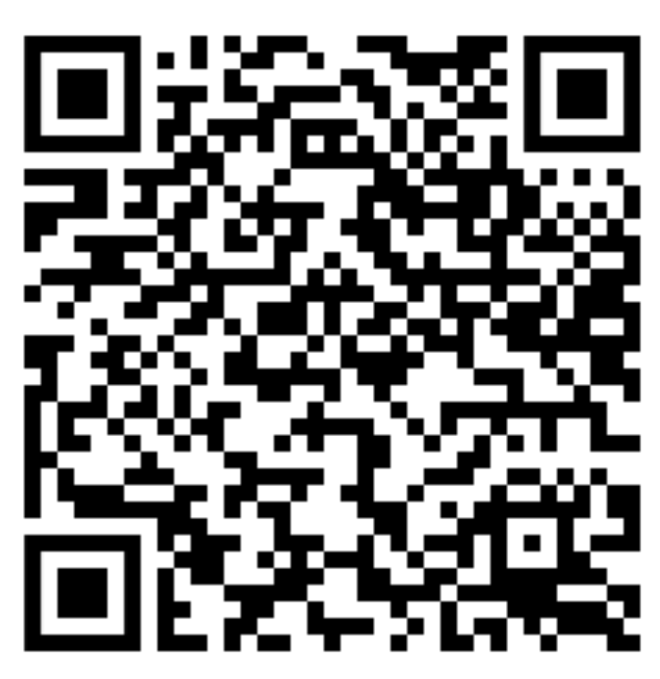
Diolch / Thank you
Reducing Health Inequalities through Primary Care - Primary Care One (nhs.wales)

